Slide 1

Bear’s
BEAR Expectations
How you should act around our Newest BEAR Family Member

Slide 2
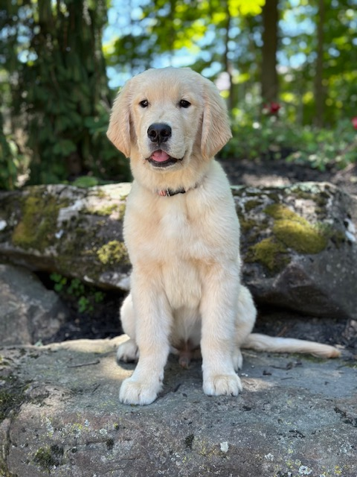
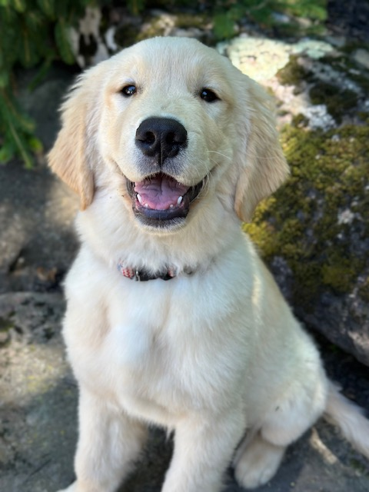
Meet Bear!

Slide 3
Who is Bear? Why is he here?
Bear is a THERAPY DOG
His JOB is to make students feel calm, happy & safe.
Today’s lesson is to show you how you are expected to INTERACT with him SAFELY & RESPONSIBLY
We will begin with a video clip on how you can tell how a dog is feeling by his / her BODY LANGUAGE
We will then go over specific BEAR Expectations for when interacting with Bear or any of his handlers.

Slide 4
How can you tell what a dog is FEELING?
Watch this:
  https://www.youtube.com/watch?v=bstvG_SUzMo
What signs show a dog is HAPPY or CALM?
What signs show Bear (or any dog) needs a break or is feeling stressed?
Why is it important to recognize these signs??

Slide 5
How we are expected to ACT around Bear?

Slide 6
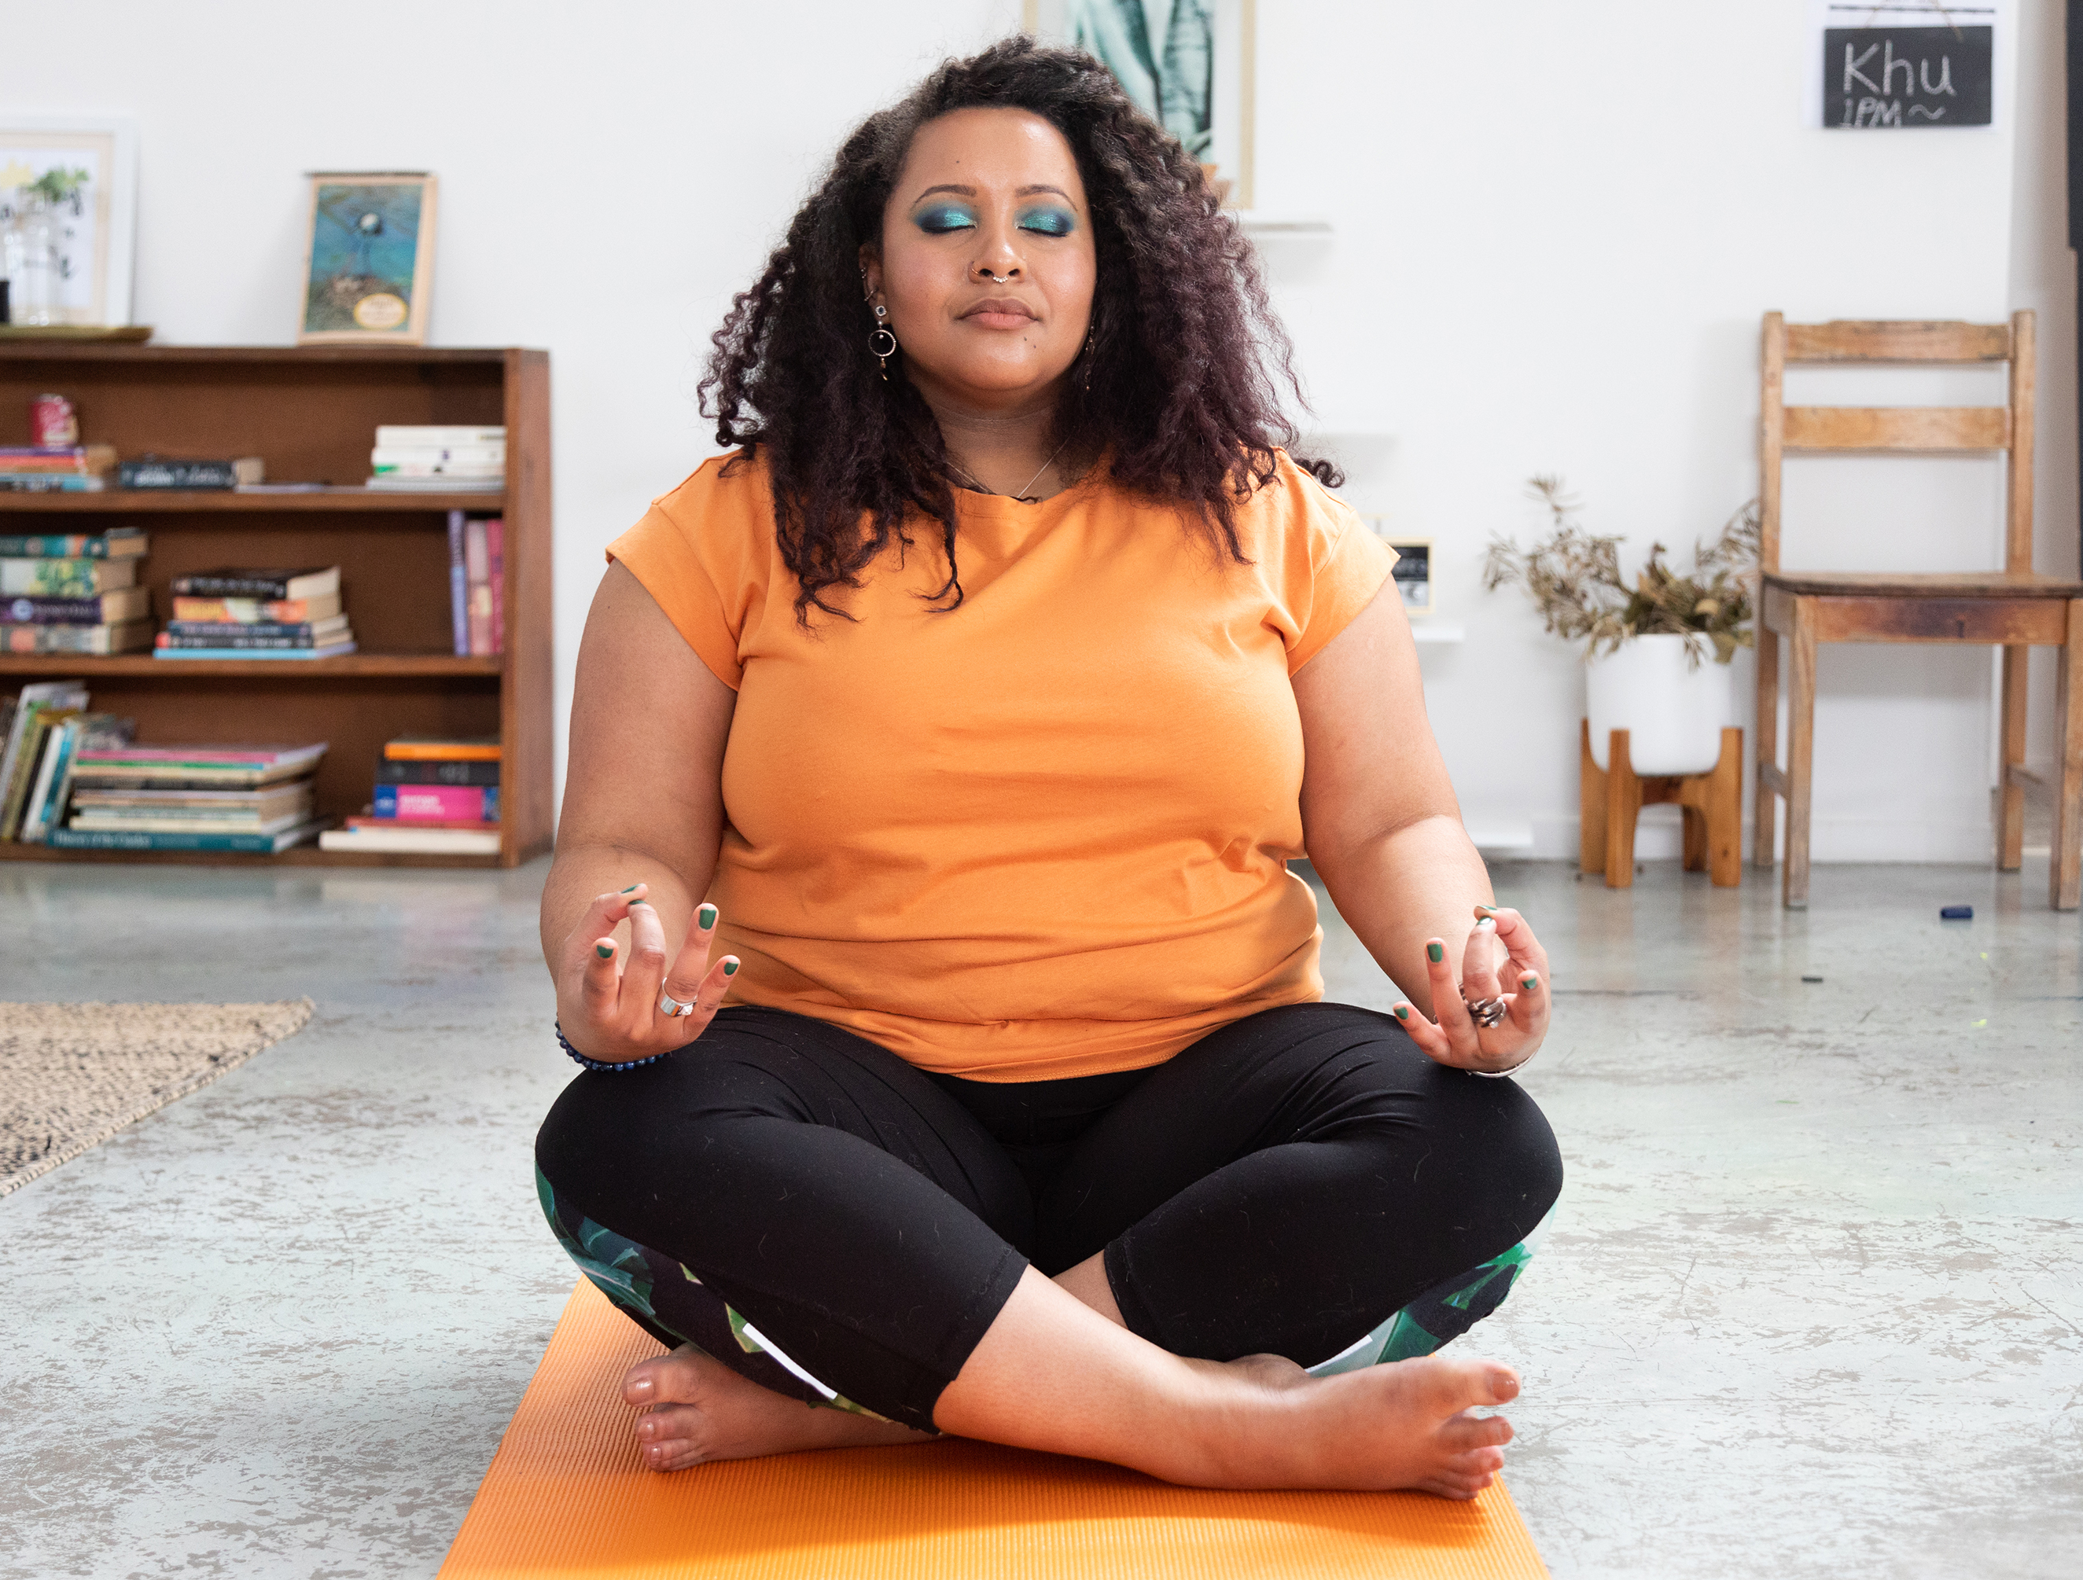

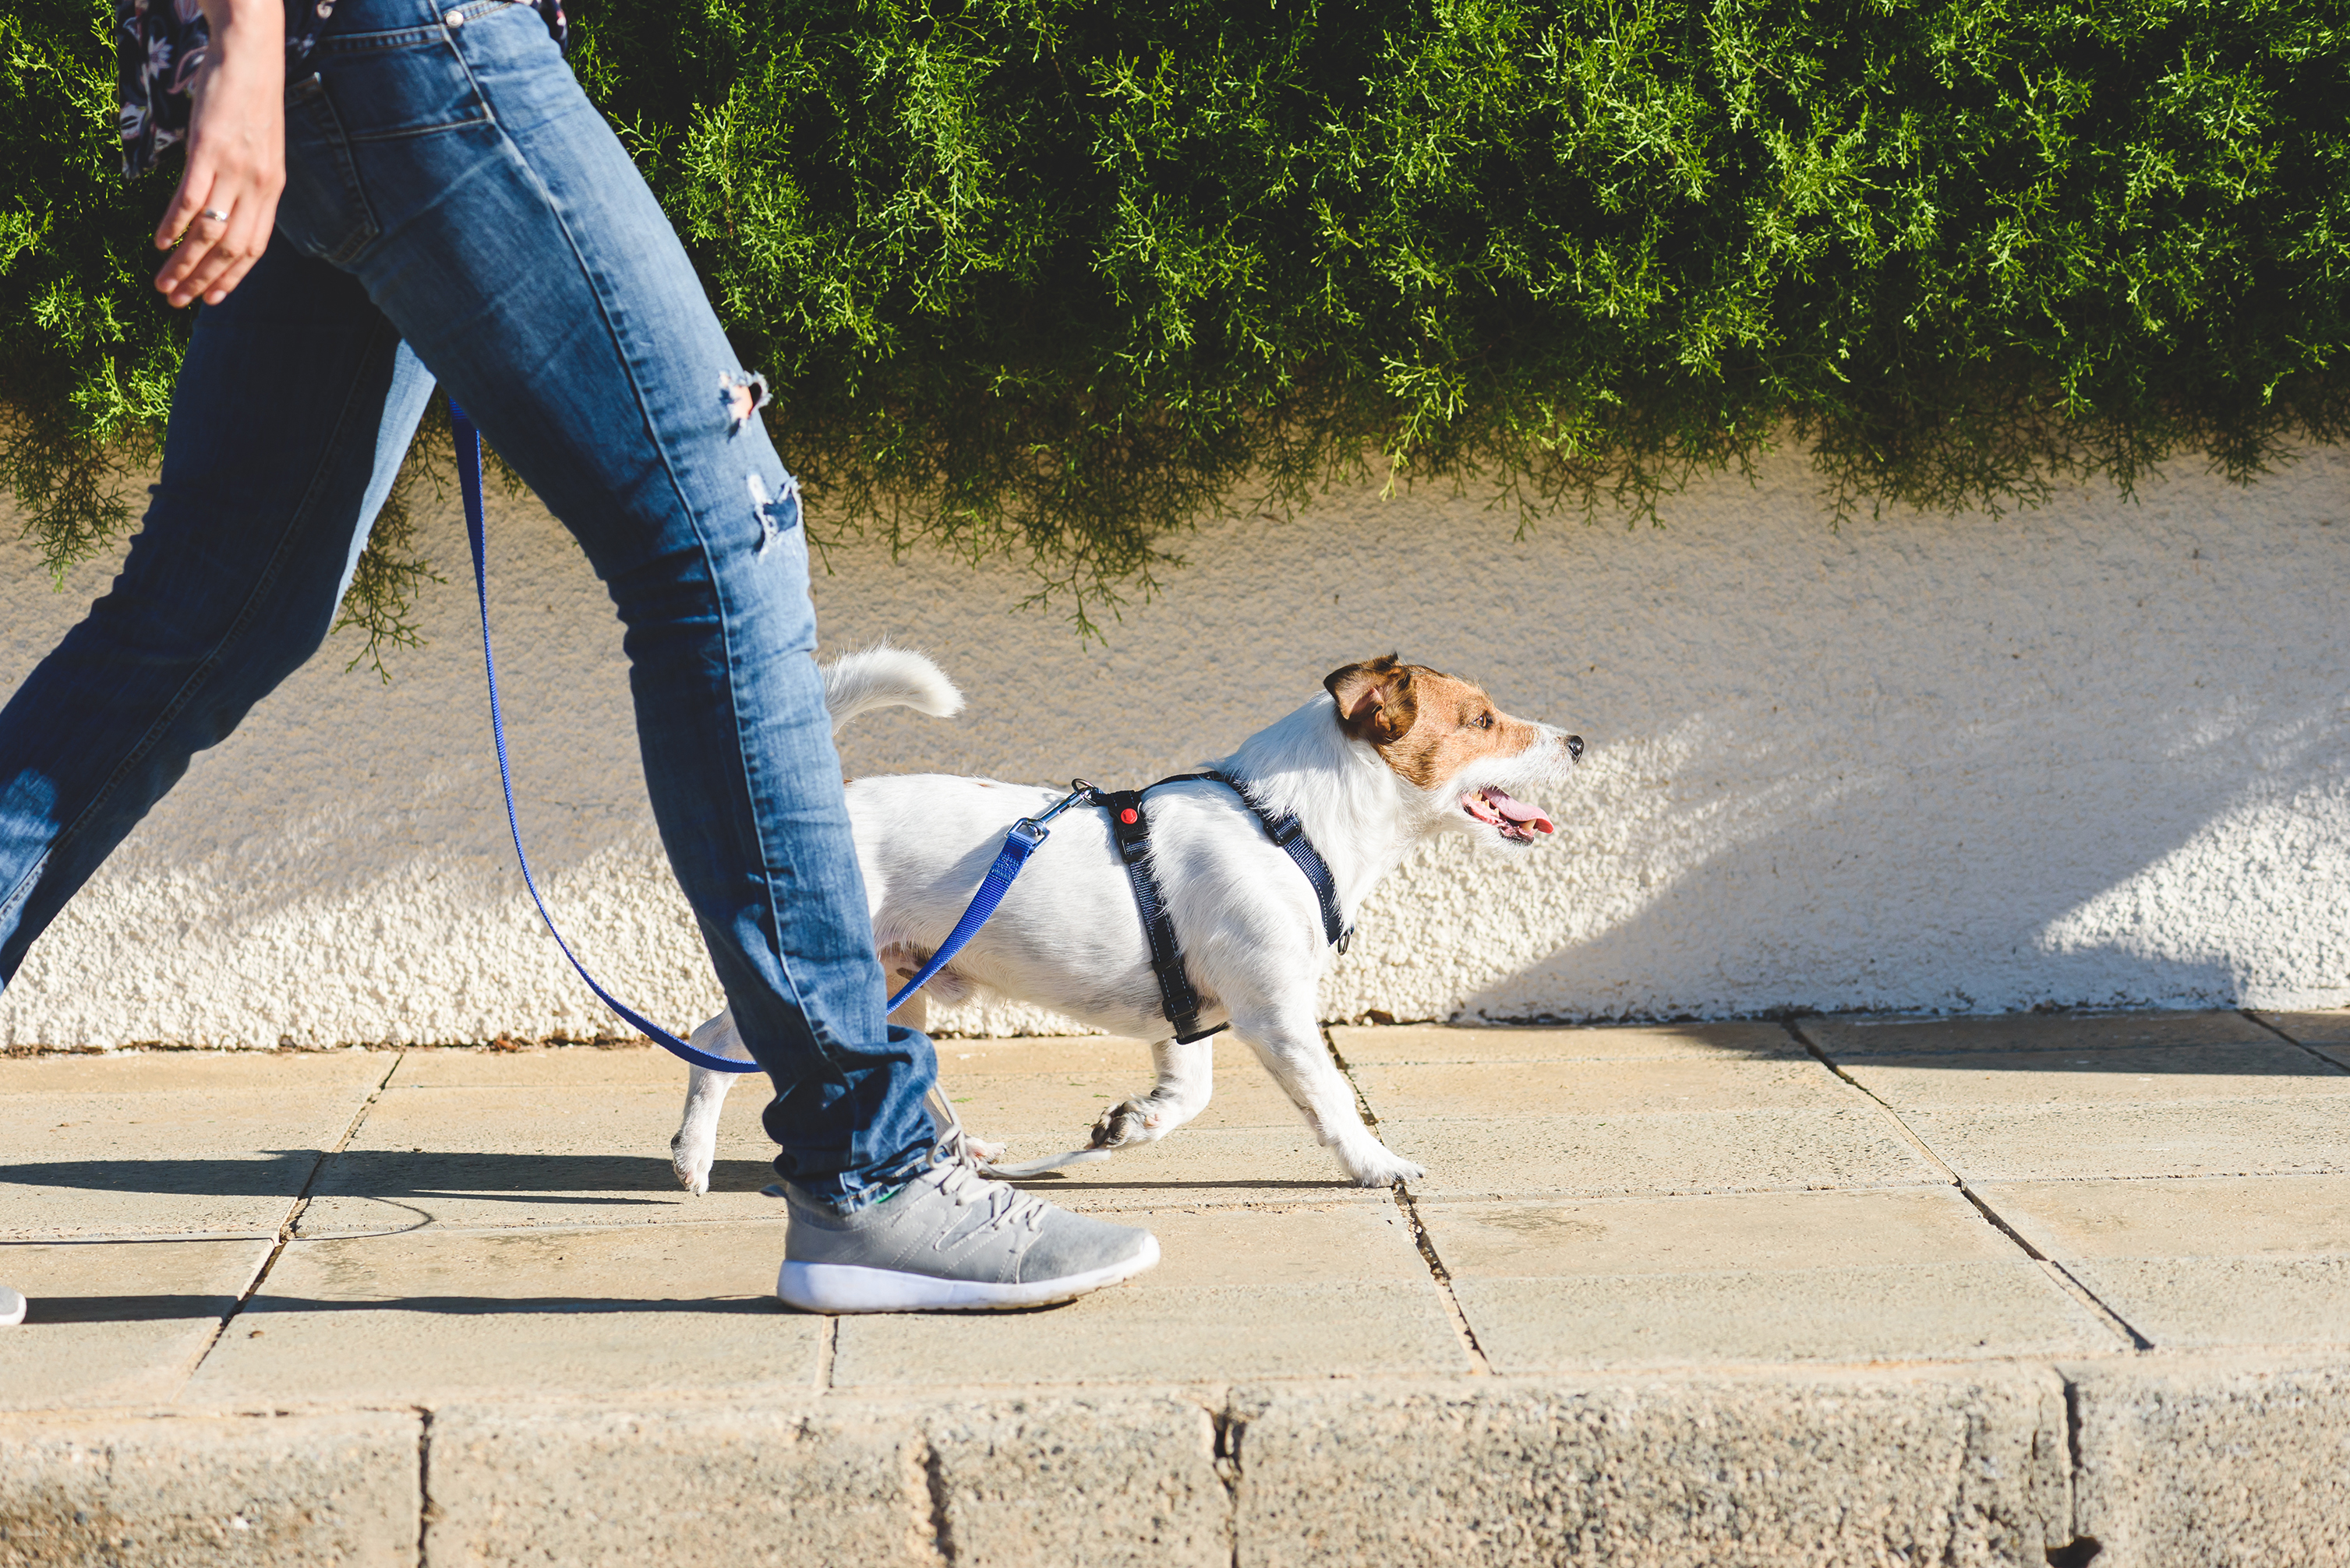
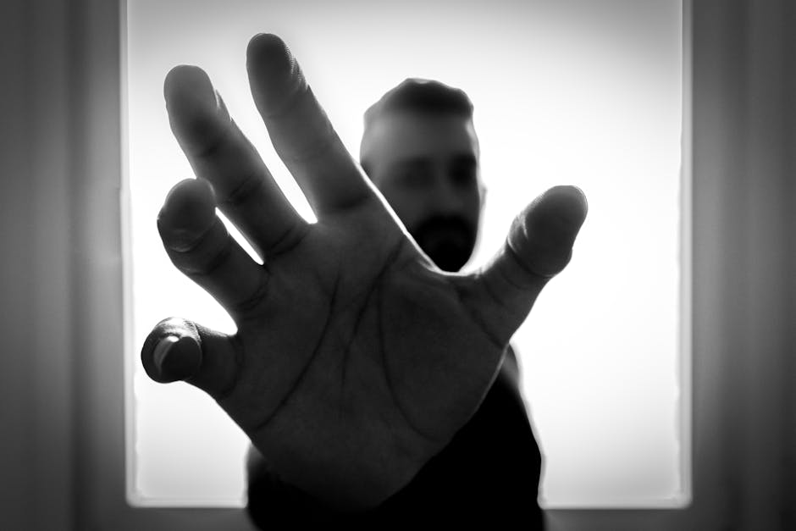
Behavior
STAY CALM
Use QUIET voices around Bear
WALK, don’t RUN, when approaching him
Avoid PULLING, YANKING, or GRABBING Bear or his leash / collar

Slide 7
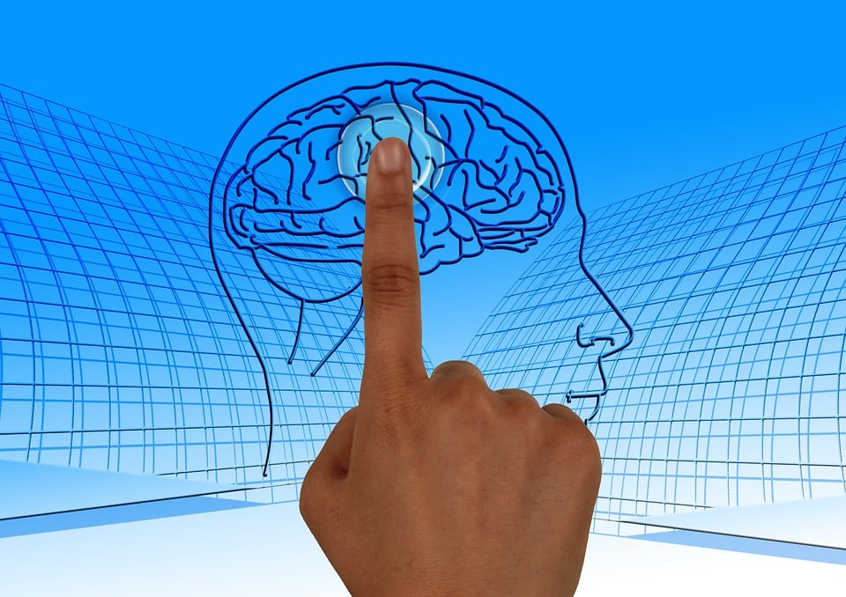

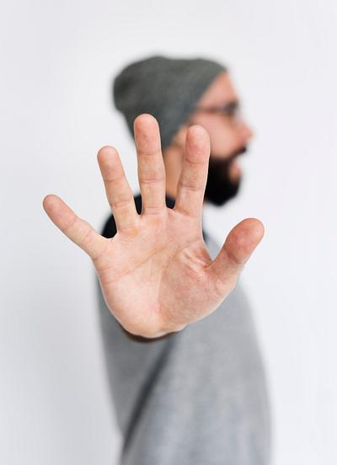
Effort
LEARN how to interact with Bear APPROPRIATELY
WAIT for your turn to greet or pet him
WATCH Bear’s body language to make sure he is comfortable

Slide 8
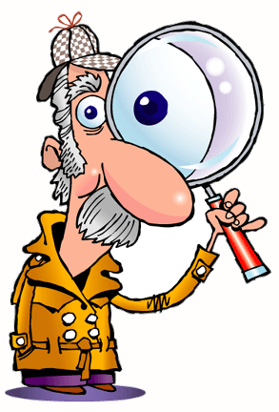
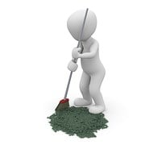
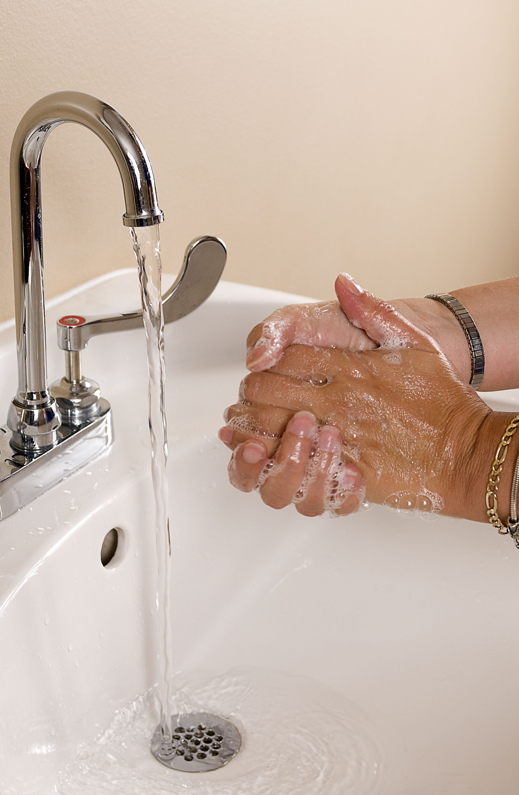
Action
PAY ATTENTION to Bear’s Handler’s instructions
Keep the area CLEAN & free of FOOD
WASH YOUR HANDS before AND after interacting with Bear

Slide 9
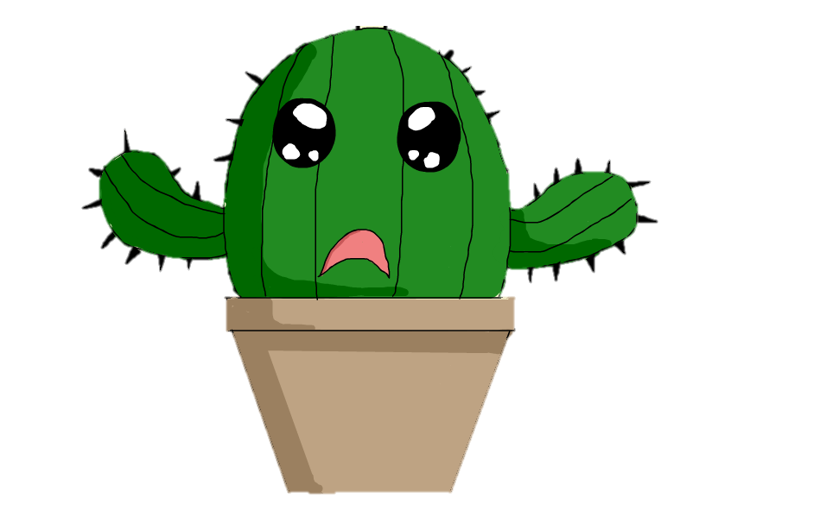
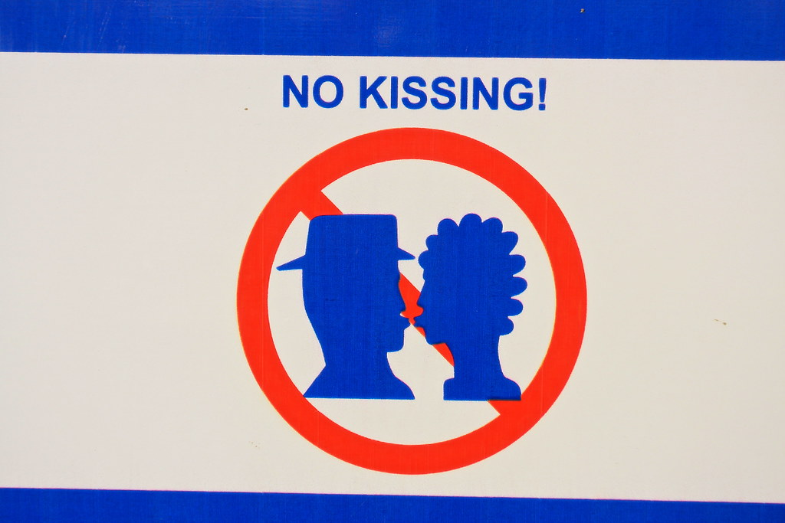
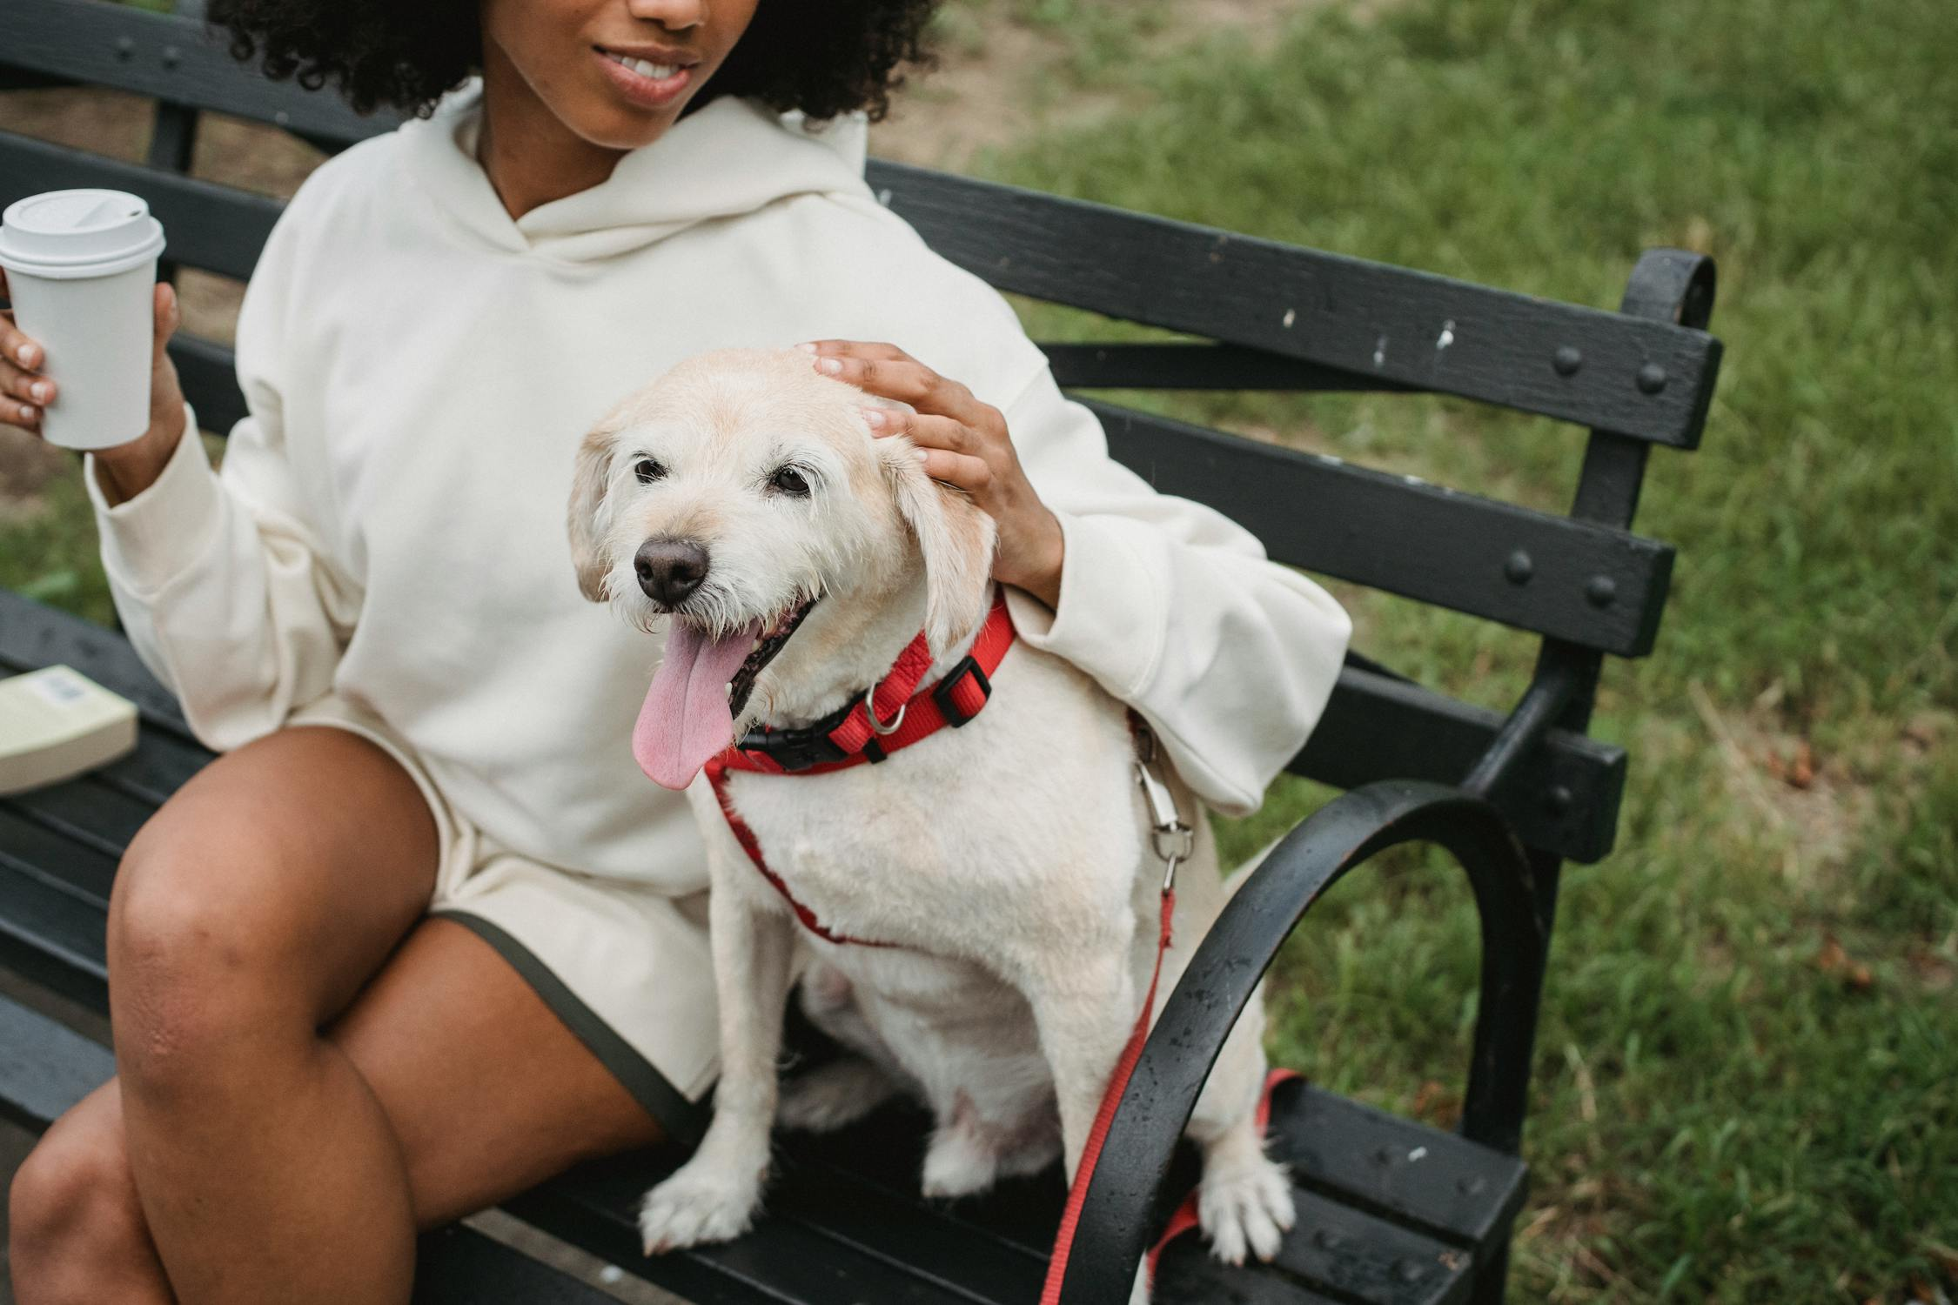
Respect
Respect Bear’s SPACE:
  No crowding,
  No hugging, without permission
  No kissing him!
Greet Bear with ONE GENTLE pet or a WAVE when passing by

Slide 10
FINAL DISCUSSIONS:
Why is it important to stay calm and follow these expectations when interacting with Bear?
How would you feel if Bear became stressed because students didn’t follow the rules?
How can you help Bear succeed at HEMS?

Slide 11
FINAL THOUGHTS
Stay calm, give Bear space, and follow the BEARS expectations.
Recognize Bear’s body language and know when he needs a break.
BE GOOD TO BEAR

